Slide 1
SIRUS TypeC 5.0Gbps Simulation Report
Red Kuo
2017.12.18

Slide 2
Summary
TypeC 5Gbps, TX->TXRX1
Net |  | L/B only | Pass Criteria
Site1 | SDD21@2.5GHz | -1.74dB | None
 | SDD11@2.5GHz | -10.78dB | None
 | Eye height | 654.6mV | None
 | Jitter | 6.8ps | None
 | Eye Width | 194.4ps | None
TypeC 5Gbps, TXRX1->TXRX2
Net |  | L/B only | Pass Criteria
Site1 | SDD21@2.5GHz | -2.56dB | None
 | SDD11@2.5GHz | -13.73dB | None
 | Eye height | 596.4mV | None
 | Jitter | 12.4ps | None
 | Eye Width | 189.2ps | None

Slide 3
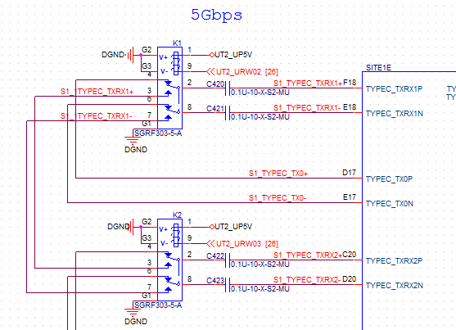
TypeC Schematic

Slide 4
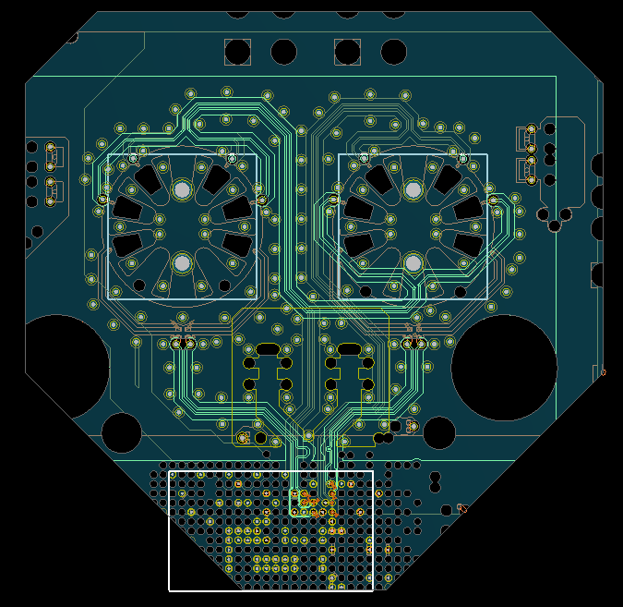
TypeC Layout

Slide 5
TX->TXRX1

Slide 6
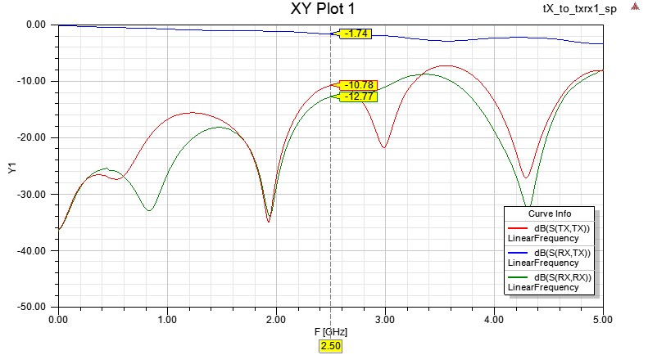
TX->TXRX1 S-parameter
Sdd21 : -1.74dB @ 2.5GHz
Sdd11 : -10.78dB @ 2.5GHz

Slide 7
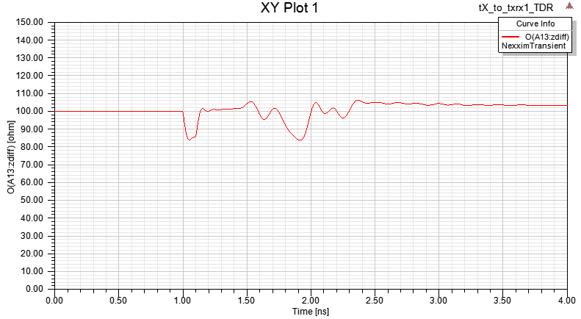
TX->TXRX1 Impedance
DUT TX
DUT TXRX1
Relay
SGRF303

Slide 8
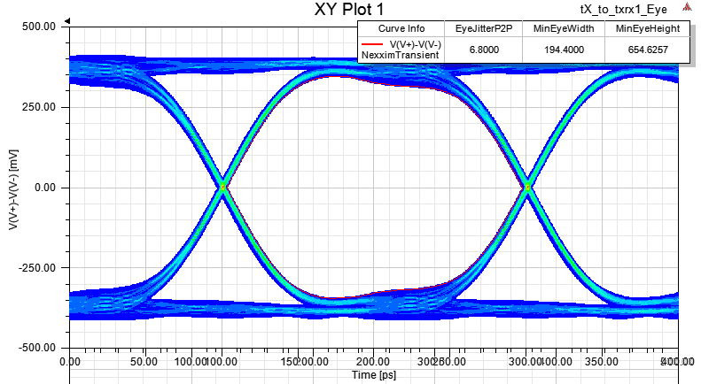
TX->TXRX1 Eye Diagram
Jitter: 6.80ps, Eye Height: 654.6mV Eye Width194.4ps

Slide 9
TXRX1->TXRX2

Slide 10
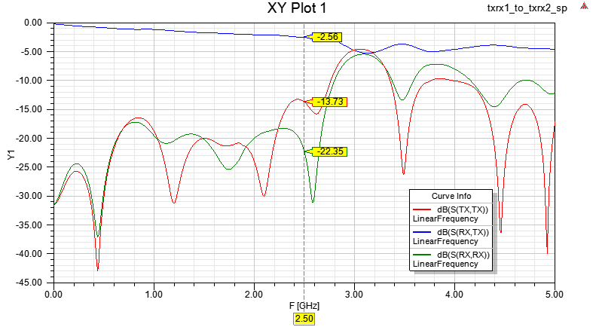
Golden IC TX to DUT RX S-parameter
Sdd21 : -2.56dB @ 2.5GHz
Sdd11 : -13.73dB @ 2.5GHz

Slide 11
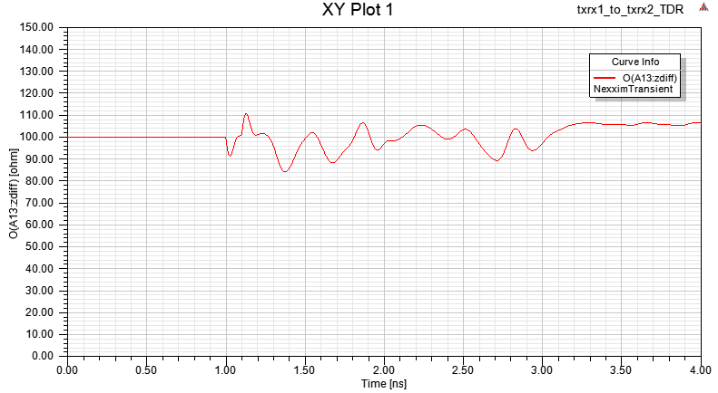
Golden IC TX to DUT RX Impedance
DUT TX
Relay
Relay
DUT TXRX1
SGRF303
SGRF303

Slide 12
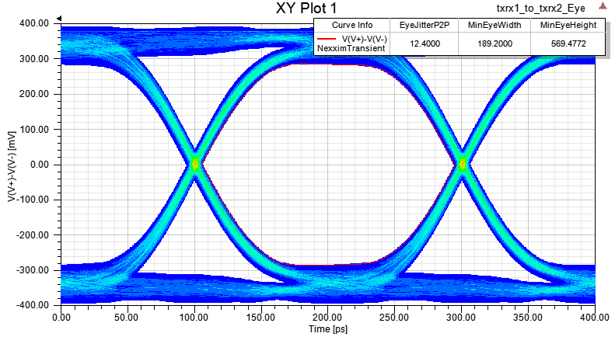
Golden IC TX to DUT RX Eye Diagram
Jitter: 12.4ps, Eye Height: 189.2mV Eye Width569.4ps

